Slide 1
Chapter 11 Vocabulary
Mr. Greaser

Slide 2
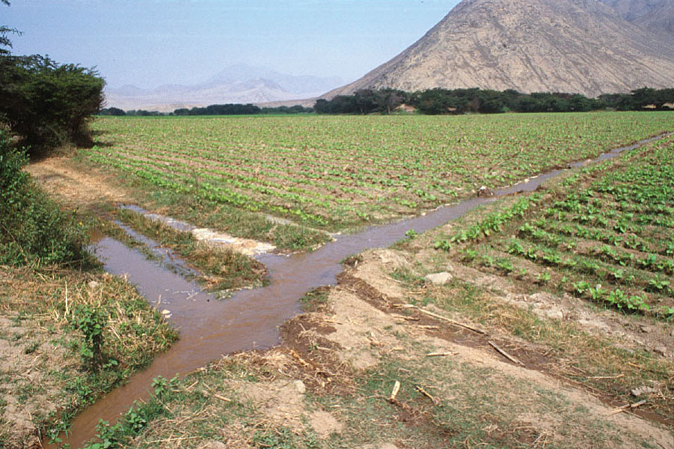
Irrigation
Process of collecting water and distributing it to crops

Slide 3
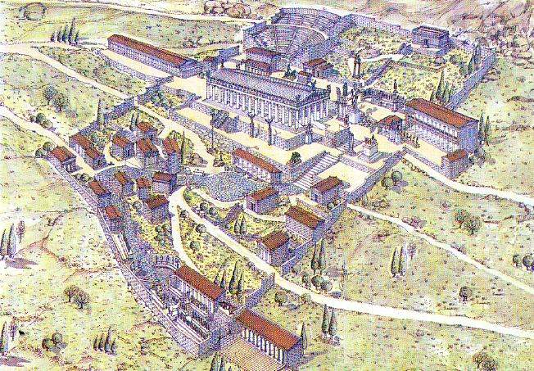
City-State
Independent political unit that includes a city and the surrounding area

Slide 4
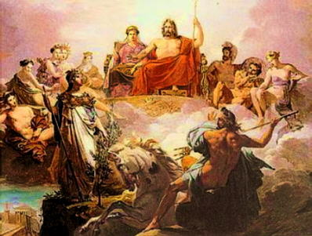
Polytheism
Belief in more than one god

Slide 5
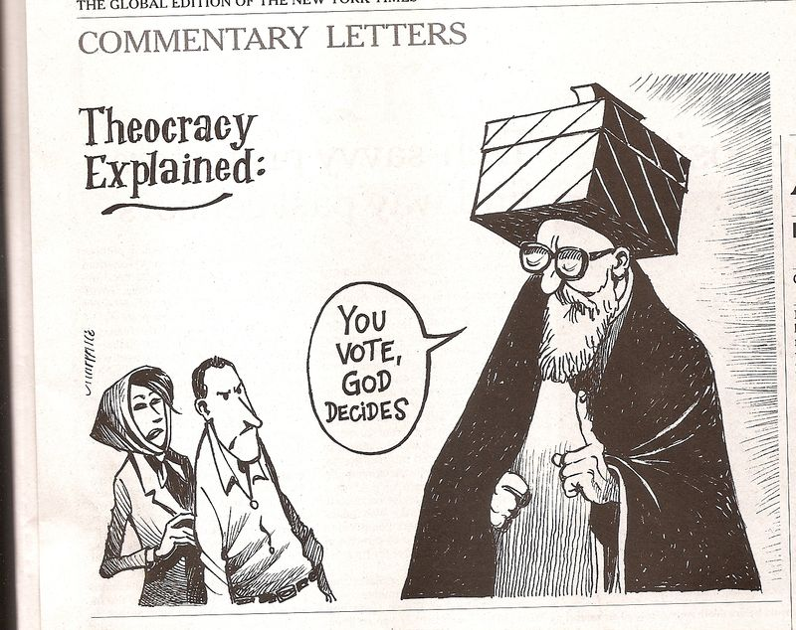
Theocracy
Form of government in which the leader claims to rule on behalf of a god

Slide 6
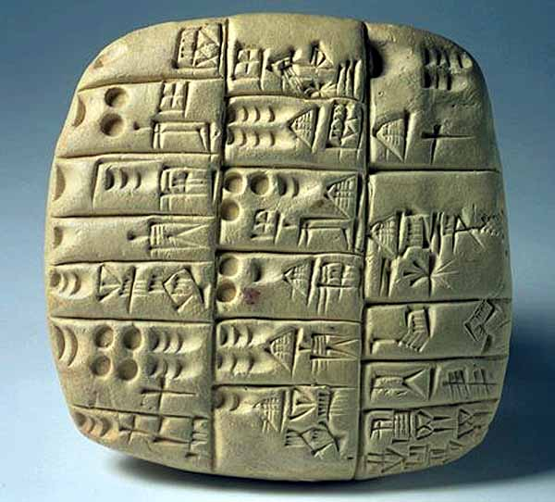
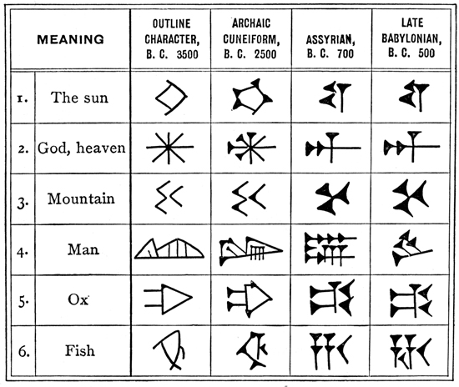
Cuneiform
Form of writing from ancient Mesopotamia that consisted of wedge-shaped markings pressed into clay tablets

Slide 7
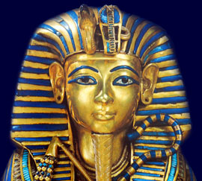
Pharaoh
Name for a powerful ruler in ancient Egypt

Slide 8
Hieroglyphics
System of writing that uses small pictures to represent sounds or words

Slide 9
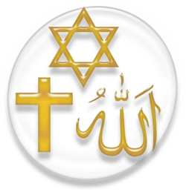
Monotheism
Belief in one god

Slide 10
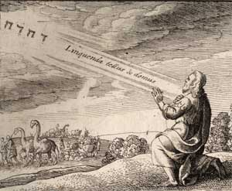
Covenant
Agreement

Slide 11
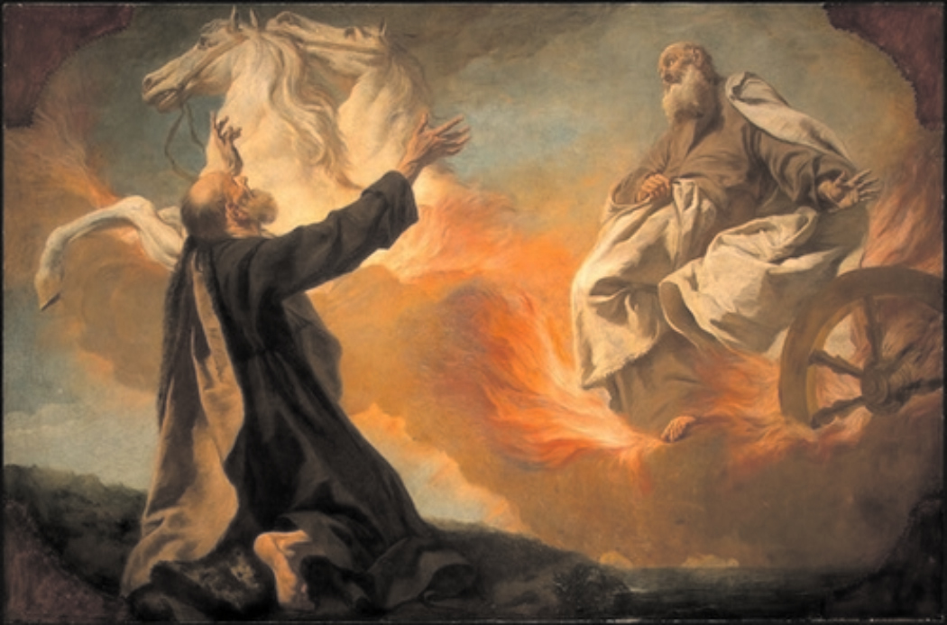
Prophet
Messenger of God

Slide 12
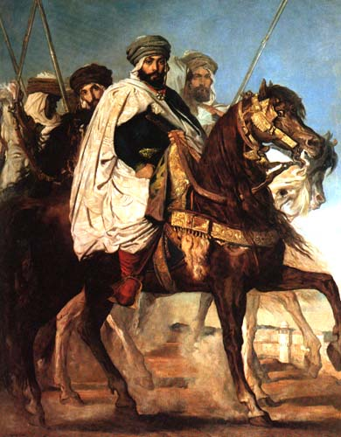
Caliph
Successor to Muhammad

Slide 13
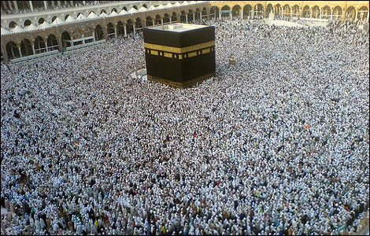
Hajj
Pilgrimage to the Muslim holy city of Makah, the completion of which at least once in a lifetime is one of the Five Pillars of Islam

Slide 14
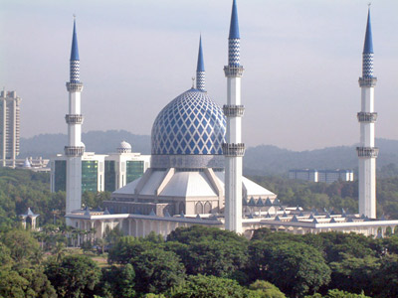
Mosque
Islamic house of worship

