Slide 1
Chapter 12 Vocabulary
Mr. Greaser

Slide 2
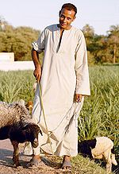
Fellahin
Peasant farmers of Egypt who rent small plots of land

Slide 3
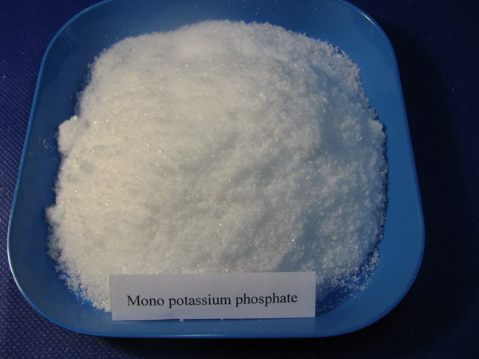
Phosphate
Chemical salt used to make fertilizer

Slide 4
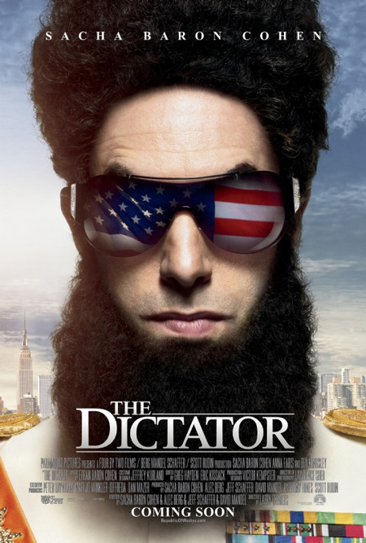
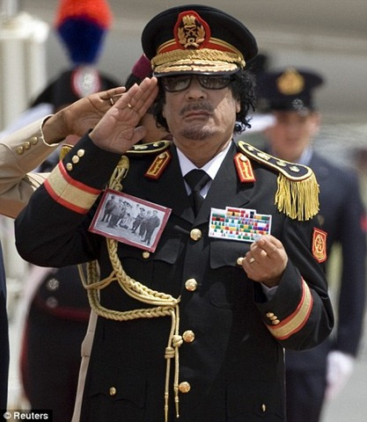
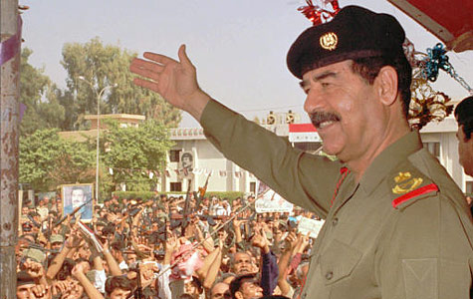
Dictatorship
Form of government in which a leader rules by force and typically limits citizen’s freedoms

Slide 5
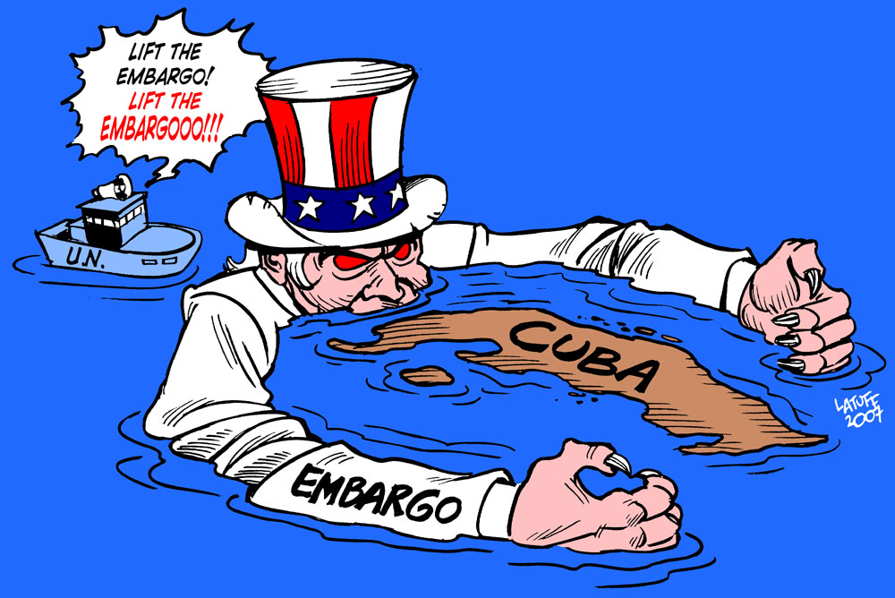
Trade Sanction
Step taken to cut off trade with a country to show opposition to its government’s actions

Slide 6
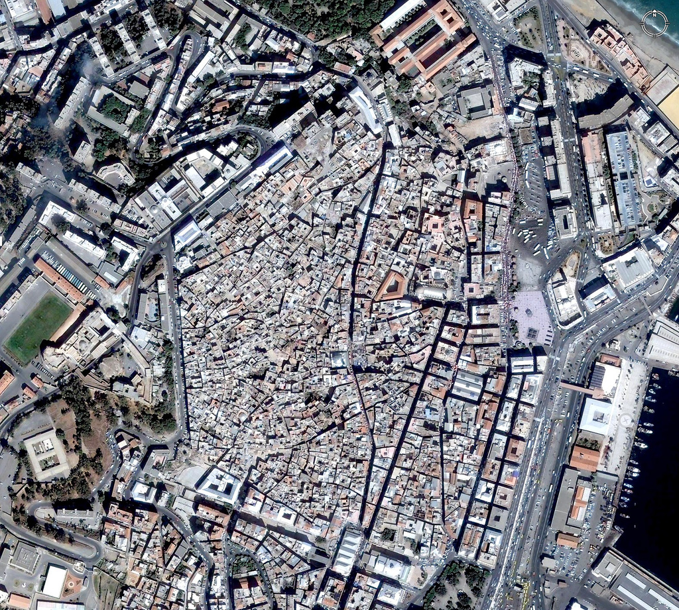
Casbah
Older section of Algerian cities

Slide 7
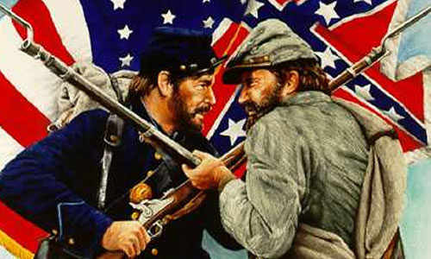
Civil War
Fight between opposing groups for control of a country’s government

Slide 8
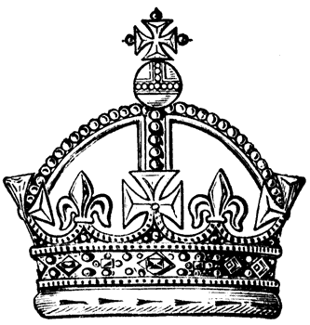
Constitutional Monarchy
Form of government in which a monarch is the head of state but elected officials run the government

Slide 9
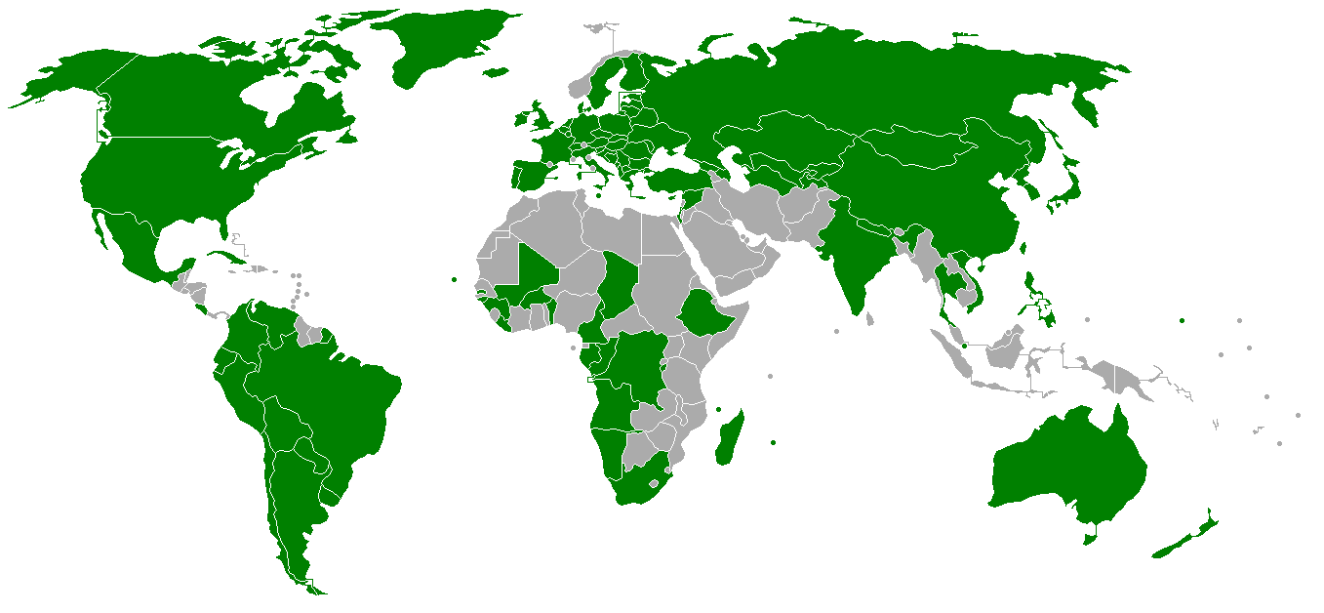
Secular
Nonreligious

Slide 10
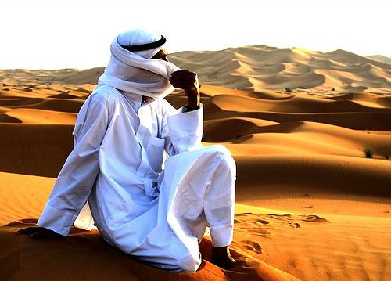
Bedouin
Nomadic desert people of the Southwest Asia who follow a traditional way of life

Slide 11
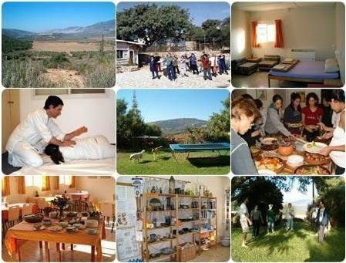
Kibbutz
Settlement in Israel where settlers share all their property and make goods as well as carry out farming

Slide 12
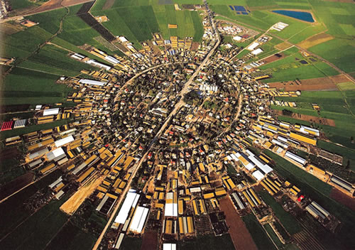
Moshav
Settlement in Israel in which people share in farming, production, and selling, but each person is allowed to own some private property as well

Slide 13
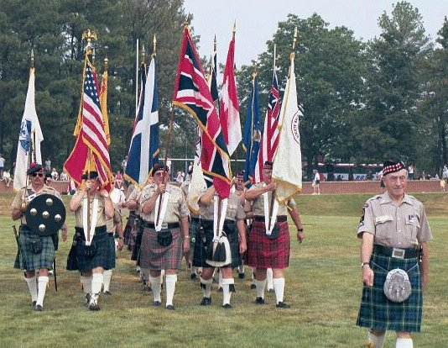
Clan
Large group of people who have a common ancestor in the far past

Slide 14
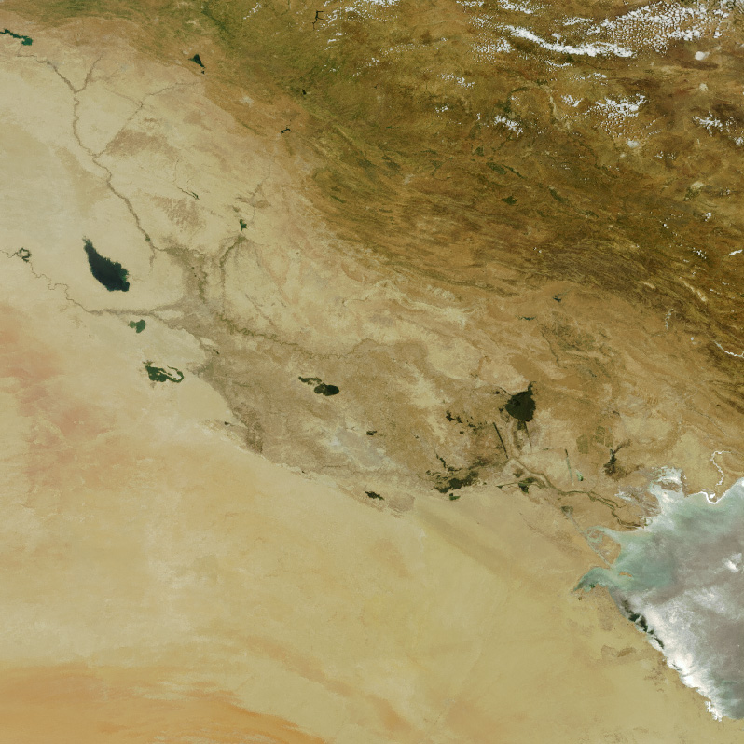
Alluvial Plain
Area built up rich fertile soil left by river floods

Slide 15
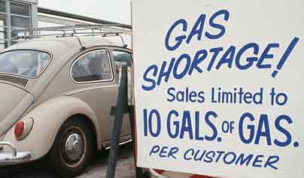
Embargo
Ban on trade with a particular country

Slide 16
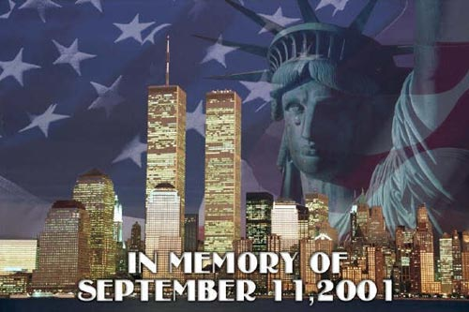
Terrorism
Violence used against the people or the government in the hopes of winning political goals

