Slide 1
Chapters 17 and 18 Vocabulary
Mr. Greaser

Slide 2
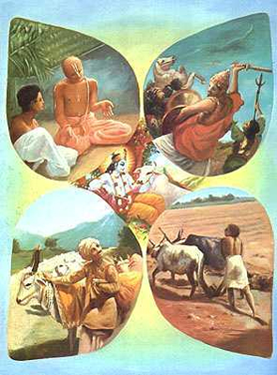
Varna
One of the four broad classes of human society under Hinduism

Slide 3
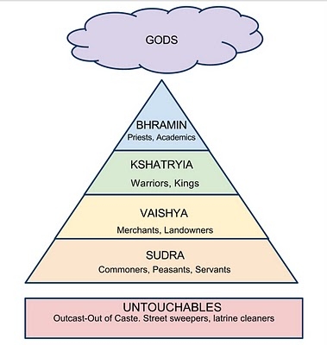
Caste
Social class a person is born into and can-not change

Slide 4
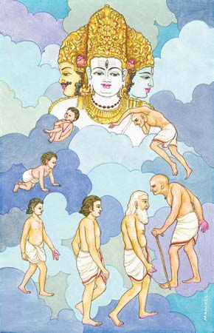
Reincarnation
Belief that after a person dies, his or her soul is reborn into another body

Slide 5
Dharma
Duty in Hinduism

Slide 6
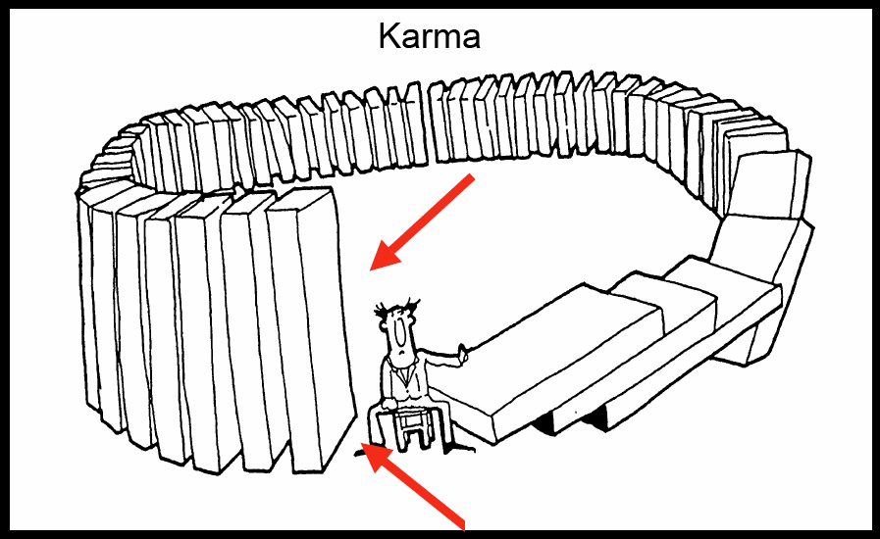
Karma
Belief in Hinduism, that one’s actions in past lives determine the spiritual level into which one is reborn

Slide 7
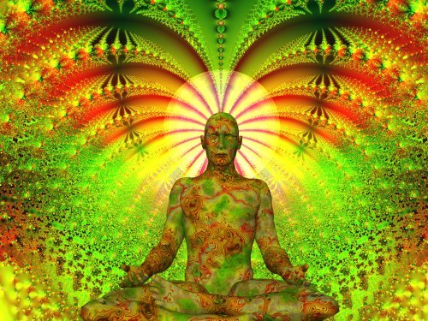
Nirvana
State of perfect peace and an end to the cycle of rebirth; the goal of following the Eightfold Path in Buddhism

Slide 8
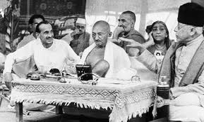
Civil Disobedience
Use of nonviolent protests to challenge a government or its laws

Slide 9
Boycott
To refuse to buy items from a particular country

Slide 10
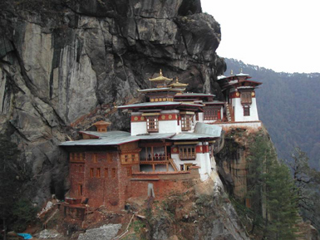
Dzong
Buddhist center of prayer and study

Slide 11
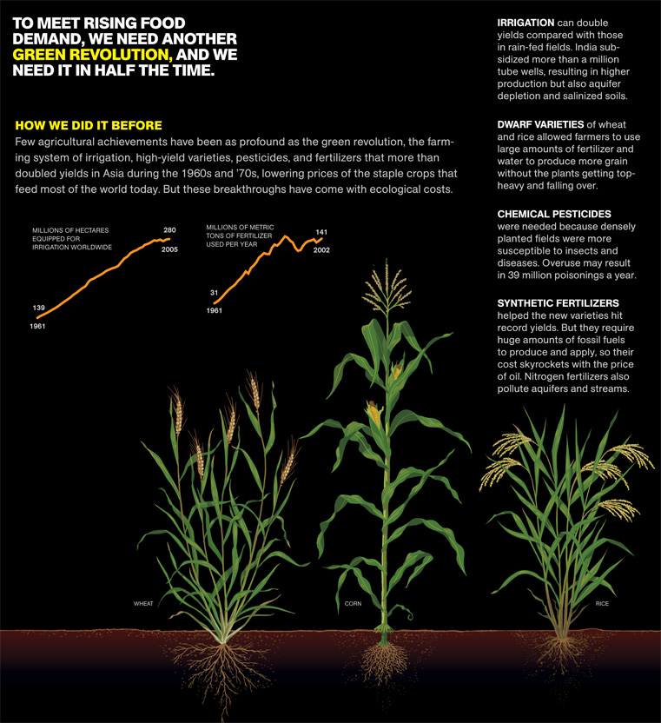
Green Revolution
Effort to use modern techniques and science to increase food production in poorer countries

Slide 12
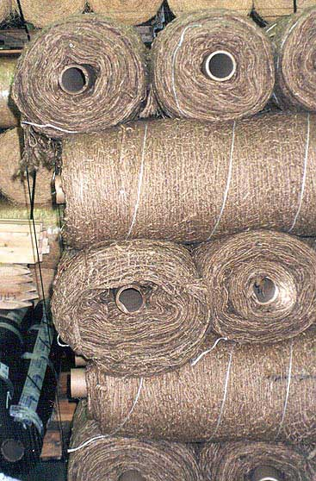
Jute
Plant with a tough fiber that is used for making rope, burlap bags, and carpet backing

Slide 13
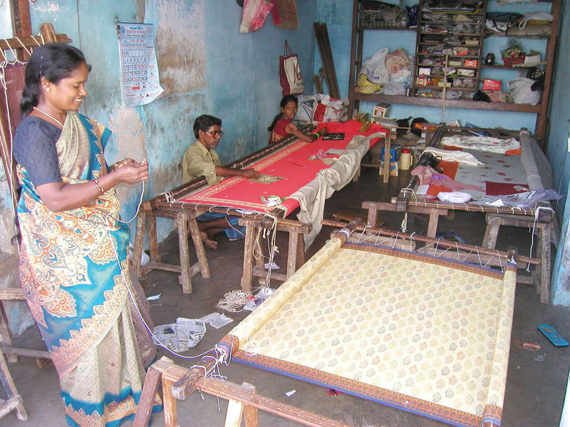
Cottage Industry
Home-or village-based industry in which people make simple goods using their own equipment

Slide 14
Outsourcing
Hiring workers in other countries to do a set of jobs

Slide 15
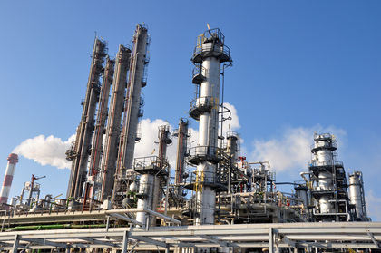
Nationalize
Taking control of an industry or company by a government

Slide 16
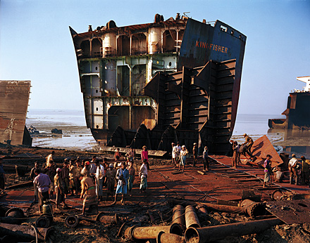
Ship breaking
Bringing ashore large ships that are retired and are cut into pieces and sold

Slide 17
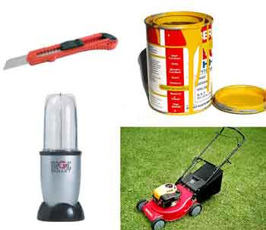
Consumer goods
Products people use for personal use

Slide 18
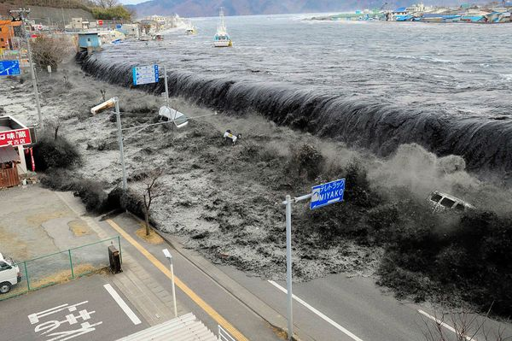
Tsunami
Huge ocean wave caused by an earthquake on the ocean floor

