Slide 1
Chapter 1 Vocabulary
Mr. Greaser

Slide 2
Geography
The study of the earth and its people

Slide 3
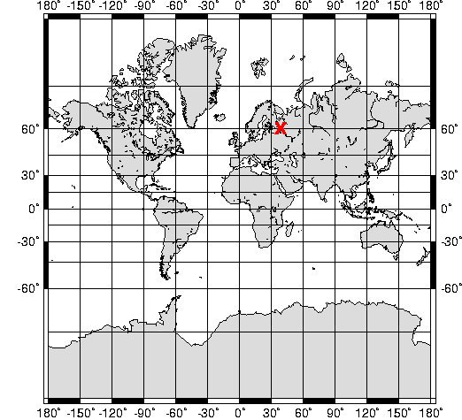
Absolute Location
Exact spot where a place is found

Slide 4
Relative Location
Description of where a place is in relation to the features around it

Slide 5
Environment
Natural surroundings of the people

Slide 6
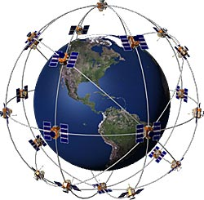
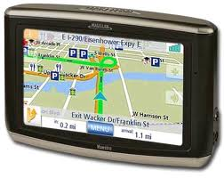
Global Positioning System
Group of satellites that uses radio signals to determine the exact location of places on Earth

Slide 7
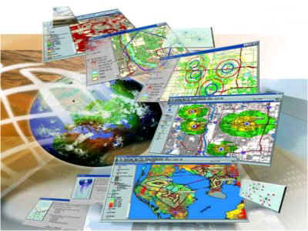
Geographic Information System
Combination of computer hardware and software used to gather, store, and analyze information and then display it on a screen

Slide 8
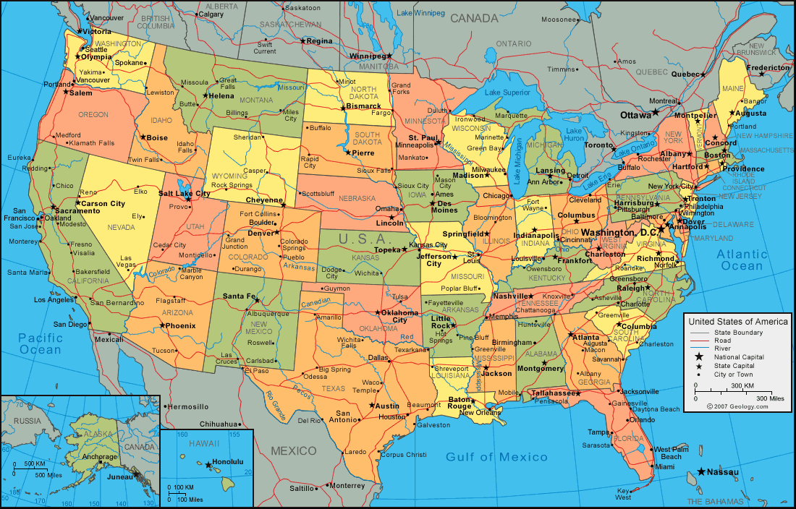
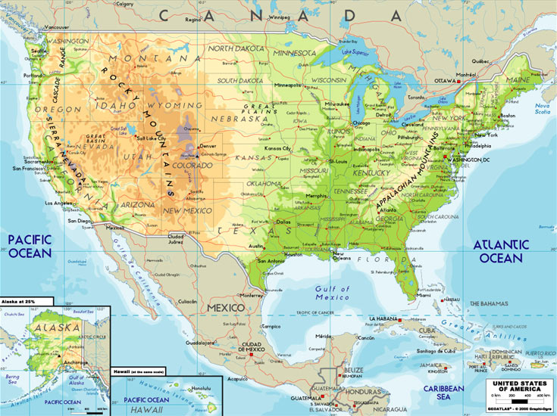
General Purpose Map
Maps that show a wide range of information

Slide 9
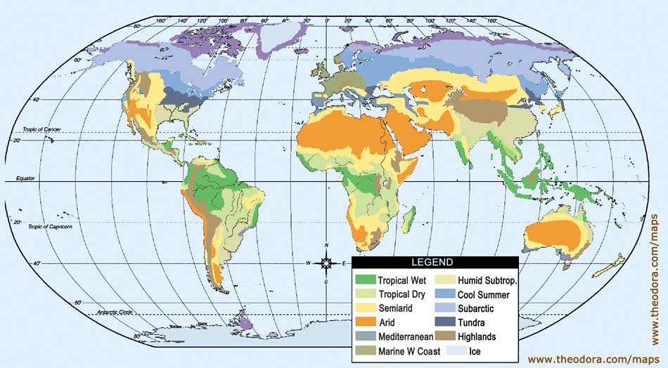
Special Purpose Map
Maps that usually show specific topics in detail

Slide 10
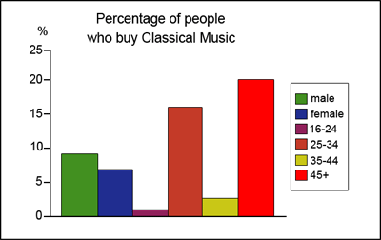
Bar Graphs
Graphs that use bars or wide lines to compare data visually

Slide 11
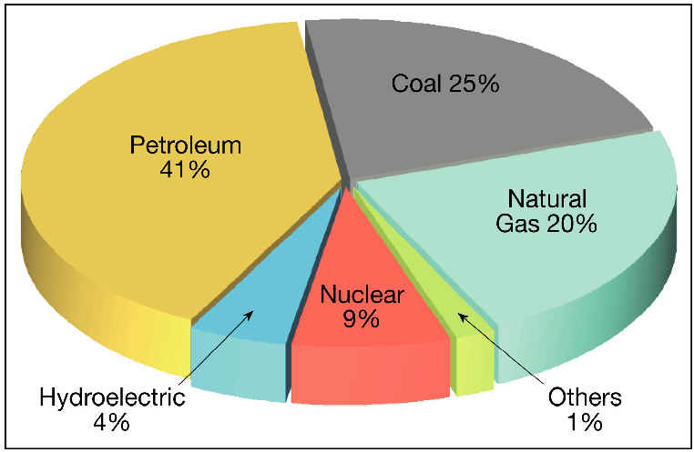
Circle Graphs
Graphs that show the whole of something divided into parts

Slide 12
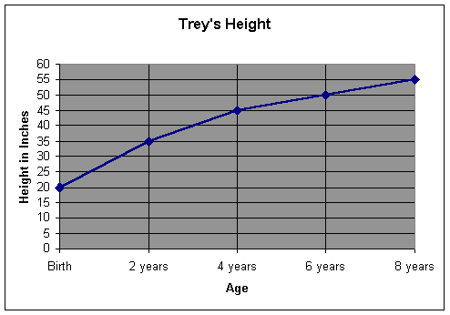
Line Graphs
Graphs that show changes over a period of time

Slide 13
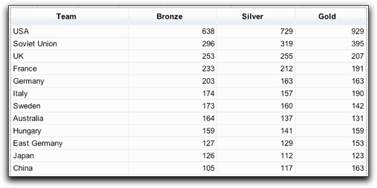
Charts
Present related facts and numbers in an organized way

Slide 14
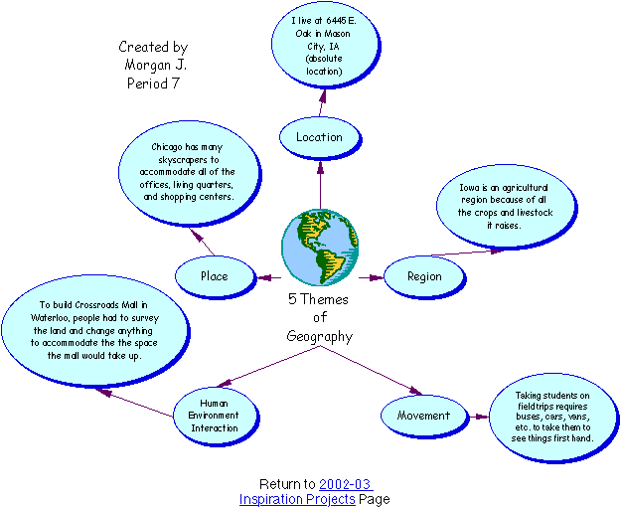
Diagrams
Drawings that show steps in a process, point out the parts of an object, or explain how something works

