Slide 1
Chapters 20 Vocabulary
Mr. Greaser

Slide 2
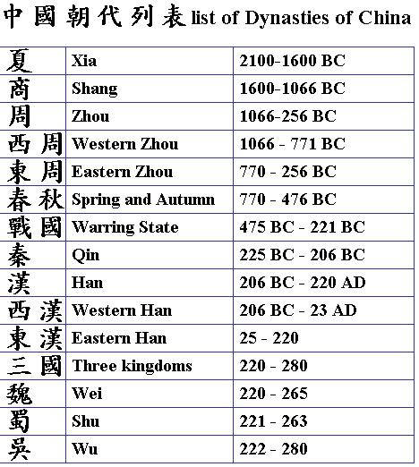
Dynasty
Line of rulers from a single family that holds power for a long time

Slide 3
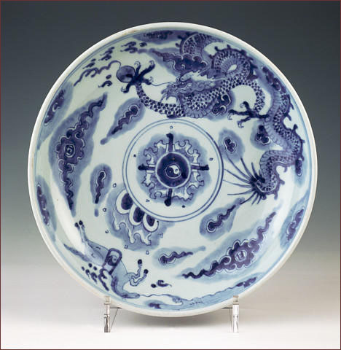
Porcelain
High-quality kind of pottery that can be very thin and is covered with a shiny coating

Slide 4
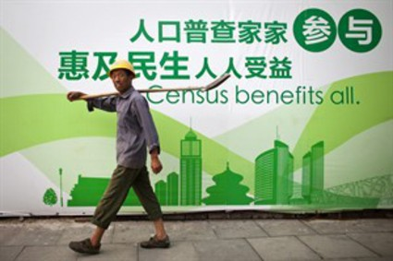
Census
A count of the number of people living in an area or country

Slide 5
Novel
Long fictional story

Slide 6
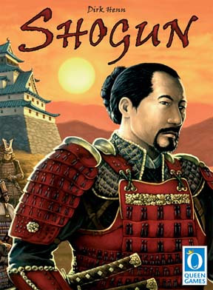
Shogun
Military leader who ruled Japan in early times

Slide 7
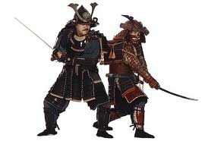
Samurai
Powerful land-owning warrior in Japan

Slide 8
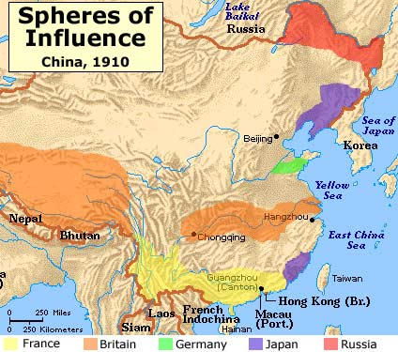
Spheres of Influence
An area of a country where a single foreign power has been granted exclusive trading rights

Slide 9
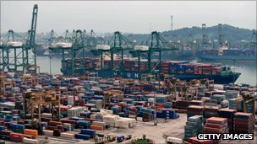
Free Port
Place where goods can be unloaded, stored, and shipped again without payment of import taxes

Slide 10
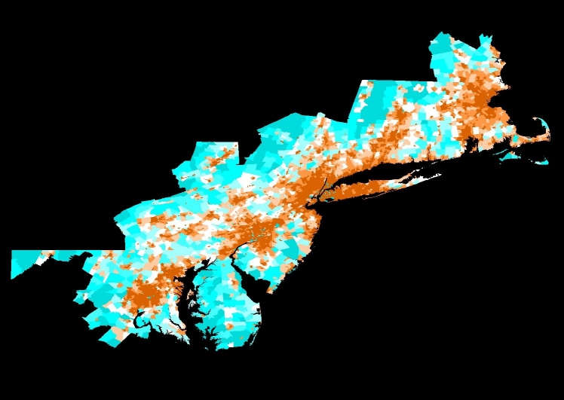
Megalopolis
Huge urban area made up of several large cities and nearby communities

Slide 11
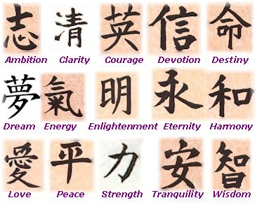
Calligraphy
Art of beautiful writing

Slide 12
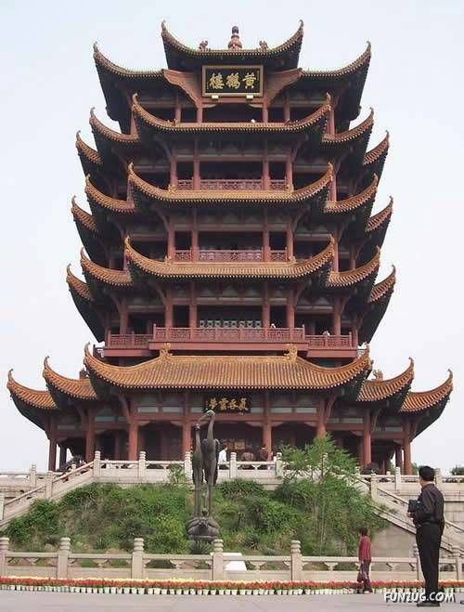
Pagoda
Tower with many stories built as a temple or memorial

Slide 13
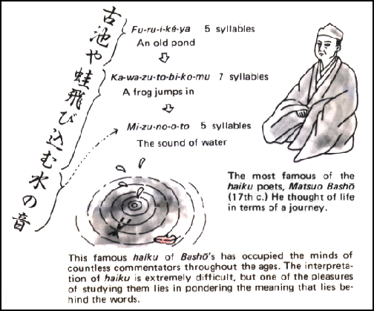
Haiku
Form of Japanese poetry known for being short and follow a specific structure

Slide 14
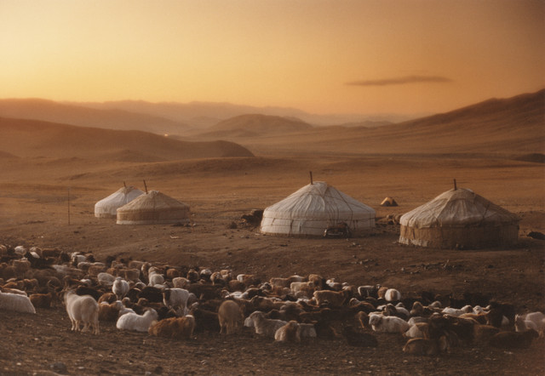
Yurt
Large circular structure made of animal skins that can be packed up and moved from place to place, used as a home in Mongolia

Slide 15
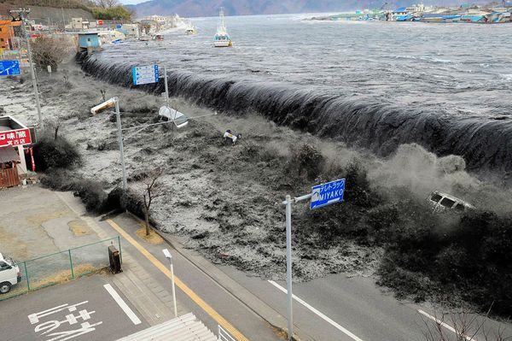
Tsunami
Huge ocean wave caused by an earthquake on the ocean floor

