Slide 1
Chapters 21 Vocabulary
Mr. Greaser

Slide 2
Human Rights
Basic freedoms and rights, such as freedom of speech, that all people should enjoy

Slide 3
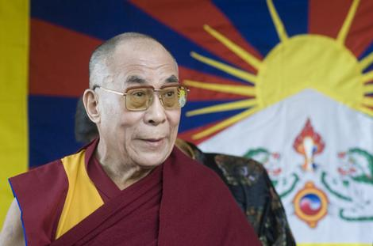
Exile
Being forced to live outside one’s country for political reasons

Slide 4
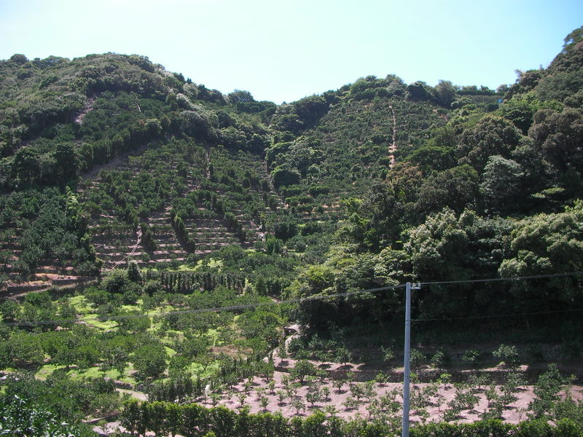
Intensive Agriculture
Kind of farming that involves growing crops on every available piece of usable land

Slide 5
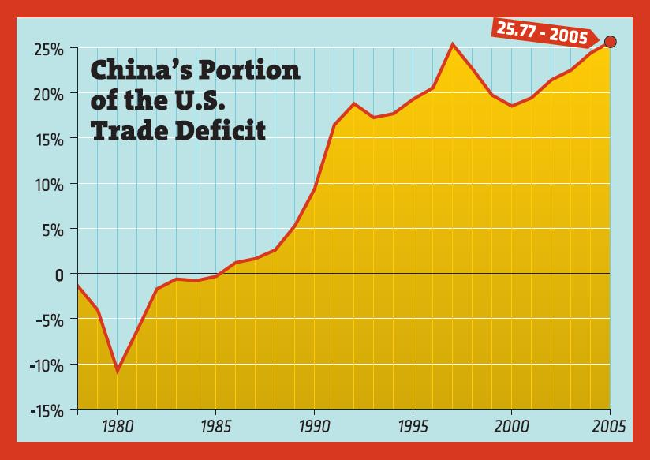
Trade Deficit
Situation that occurs when the value of a country’s imports is higher than the value of its exports

Slide 6
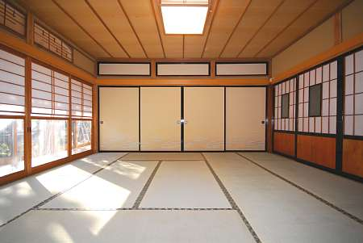
Tatami
Straw mats that are traditionally used to cover floors in Japan

Slide 7
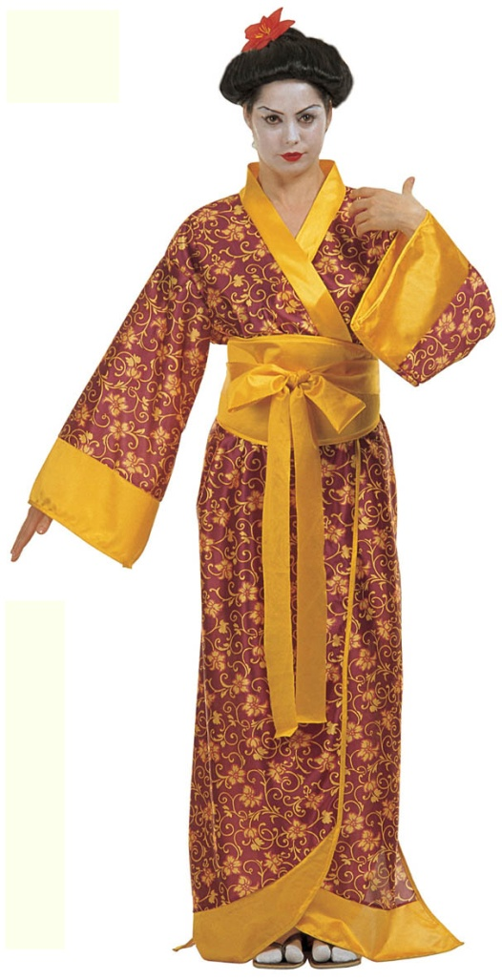
Kimono
Traditional Japanese clothing; a long robe, usually made of silk, with an open neck and large sleeves held in place by a wide sash

Slide 8
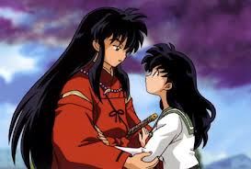
Anime
Japanese style of animation that arose in the late 1900’s and appears in comic books and cartoons

Slide 9
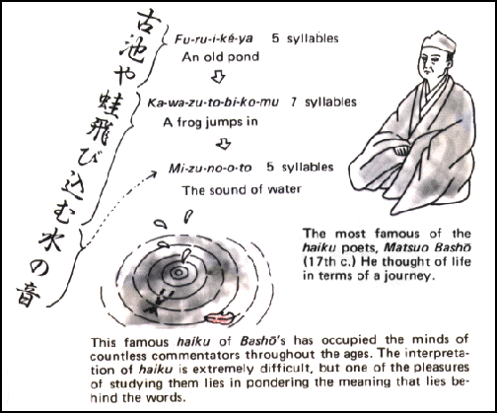
Haiku
Form of Japanese poetry known for being short and follow a specific structure

Slide 10
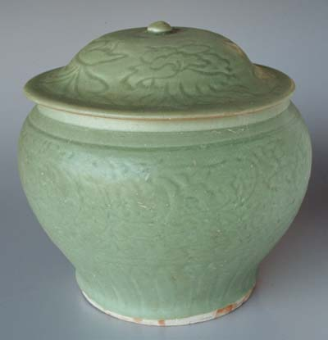
Celadon
Highly prized style of pottery that has a greenish tint

Slide 11
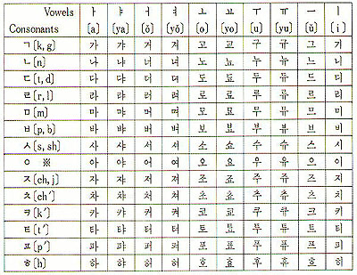
Hangul
Writing system developed in the 1400’s to write the Korean language in which characters represent sounds rather than ideas

Slide 12
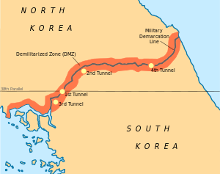
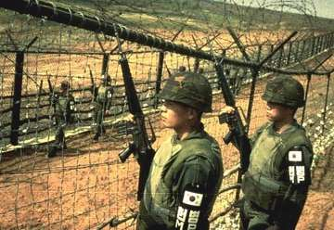
Demilitarized Zone
Area in which neighboring countries agree not to place any soldiers or weapons

Slide 13
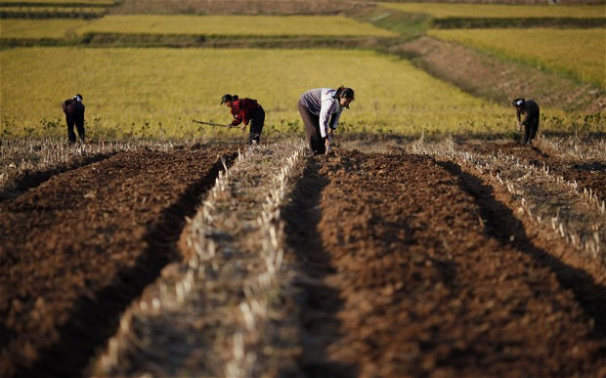
Land Reform
Policy of South Korean government that broke large estates into smaller family farms and provided fertilizer for farmers

