Slide 1
Chapter 3 Vocabulary
Mr. Greaser

Slide 2
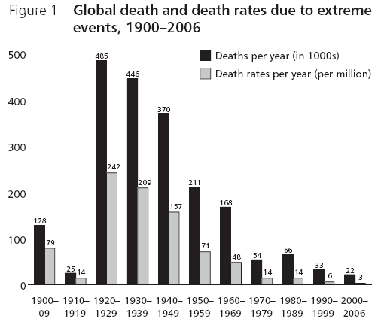
Death Rate
Number of deaths per year out of every 1,000 people

Slide 3
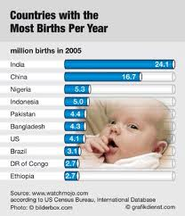
Birthrate
Number of children born each year for every 1,000 people

Slide 4
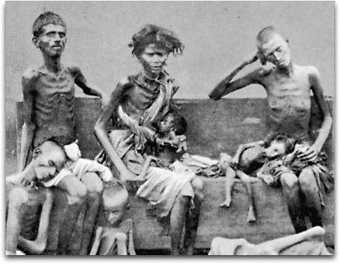
Famine
Severe lack of food

Slide 5
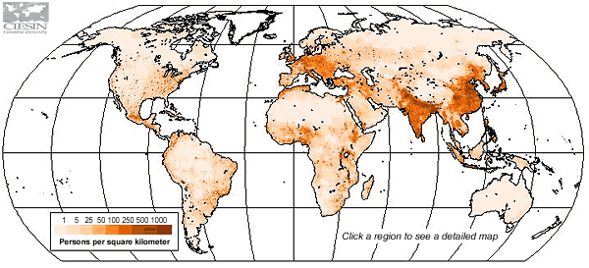
Population Density
Average number of people living in a square mile or square kilometer

Slide 6
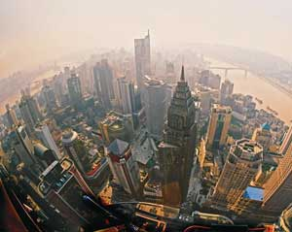
Urbanization
Growth of cities

Slide 7
Emigrate
To leave a country and move to another

Slide 8
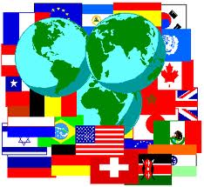
Culture
Way of life of a group of people who share similar beliefs and customs

Slide 9
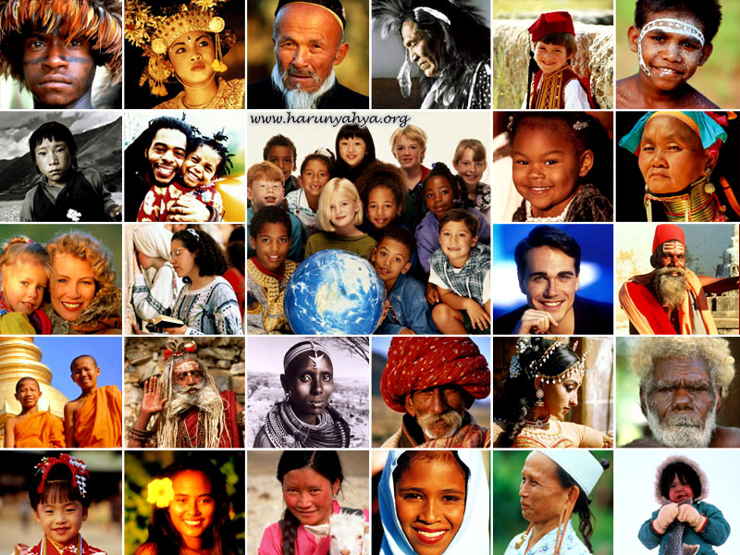
Ethnic Group
People with a common language, history, religion, and some physical traits

Slide 10
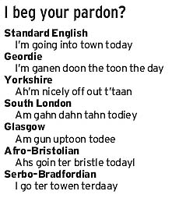
Dialect
Local form of language that may have a distinct vocabulary and pronunciation

Slide 11
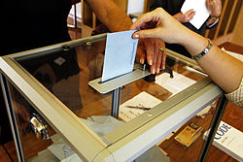
Democracy
Form of limited government in which power rests with the people, and all citizens share in running the government

Slide 12
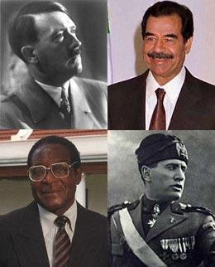
Dictatorship
Form of government in which a leader rules by force and typically limits citizen’s freedom

Slide 13
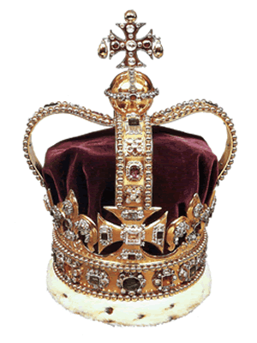
Monarchy
Government led by a king or queen who inherited power by being born into ruling family

Slide 14
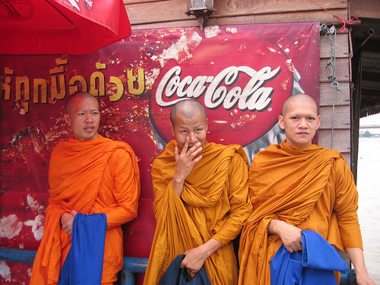
Cultural Diffusion
Process of spreading ideas, languages, and customs from one culture to another

Slide 15
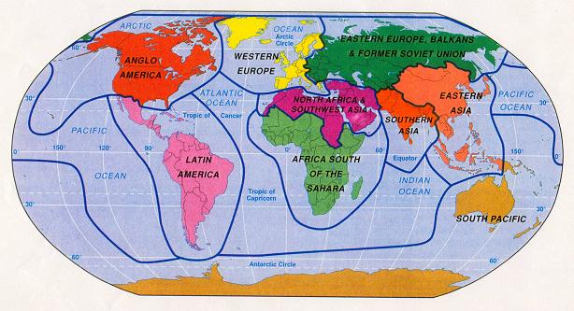
Culture Region
Area that includes different countries that share similar cultural traits

Slide 16
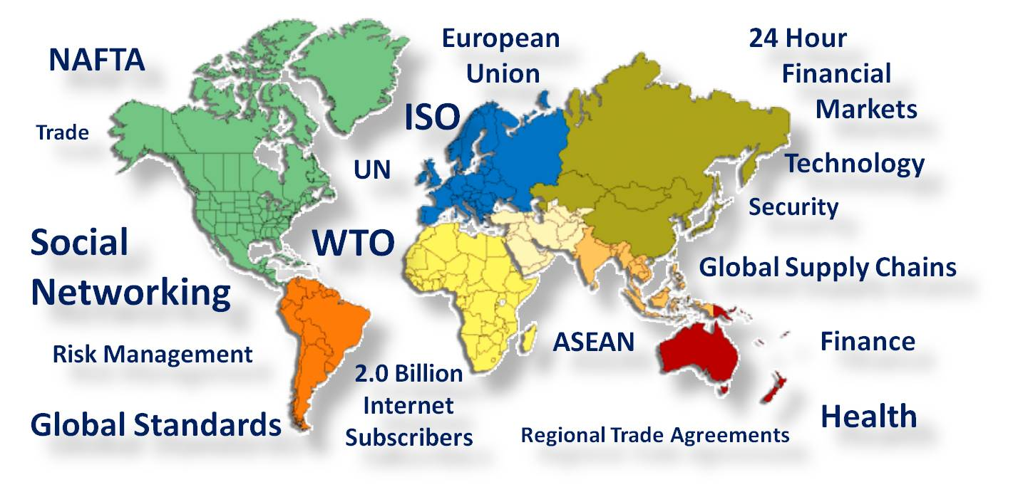
Globalization
Development of a world-wide culture with an interdependent economy

Slide 17
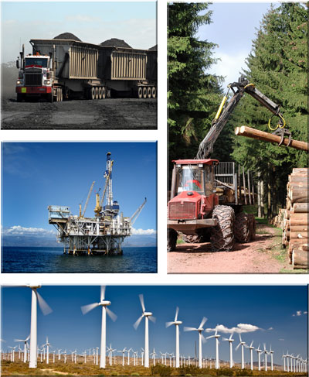
Natural Resource
Material from the Earth that people use to meet their needs

Slide 18
Renewable Resource
Natural resource that can be replaced naturally or grown again

Slide 19
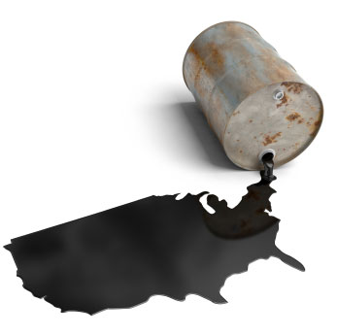
Nonrenewable Resource
Natural resource that such as a mineral that cannot be replaced

Slide 20
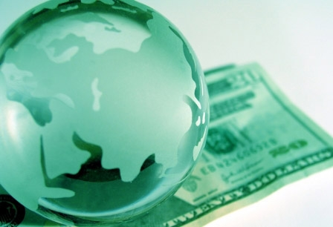
Economic System
System that sets rules for deciding what goods and services to produce, how to produce them, and who will receive them

Slide 21
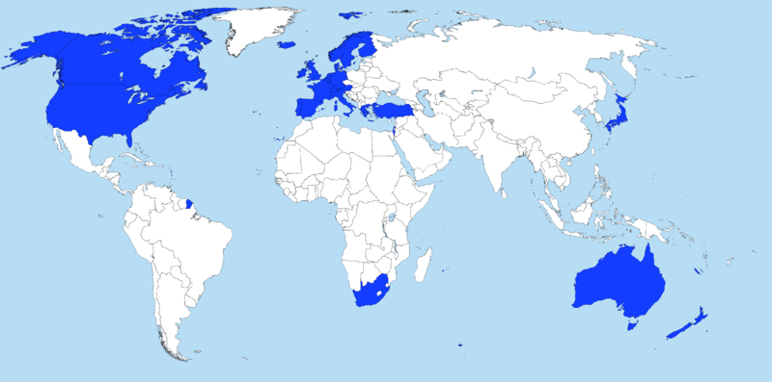
Developed Country
Country with an economy that has a mix of agriculture, great deal of manufacturing, and service industries and that is very productive and provides their people with a high standard of living

Slide 22
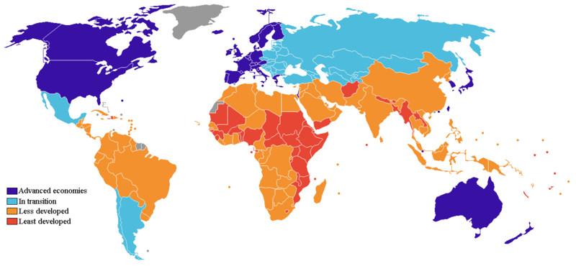
Developing Country
Country that has limited industry, where agriculture remains important, incomes are generally low

Slide 23
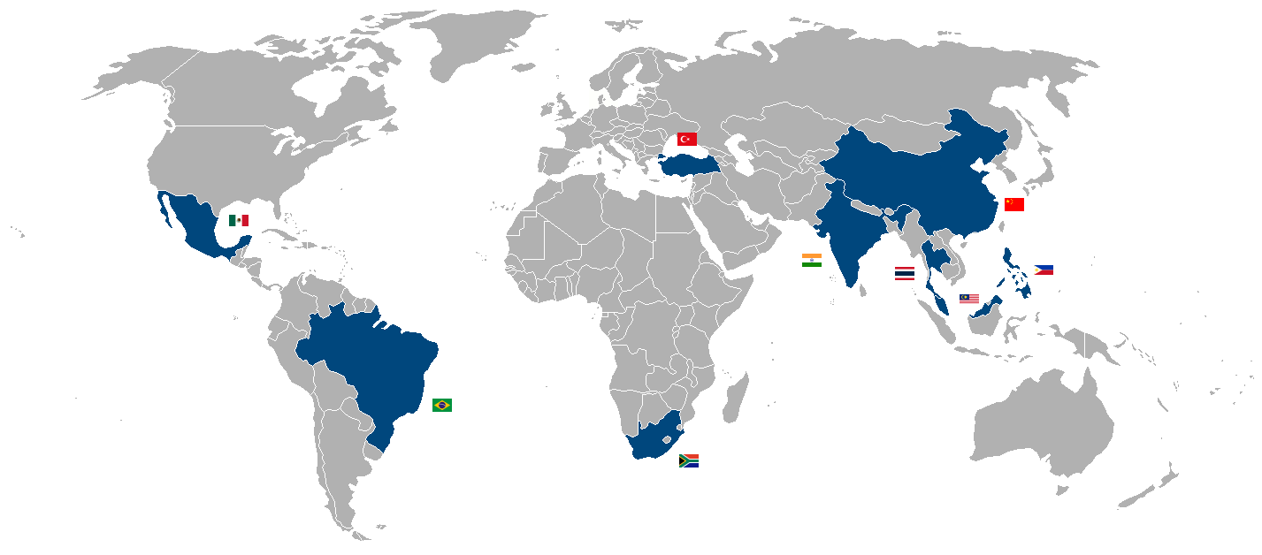
Newly Industrialized Country
Country that is creating new manufacturing and business

Slide 24
Export
To sell goods or resources to other countries

Slide 25
Import
To buy resources or goods from other countries

Slide 26
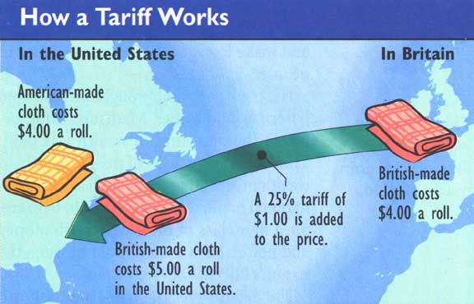
Tariff
Tax added to the price of goods that are imported

Slide 27
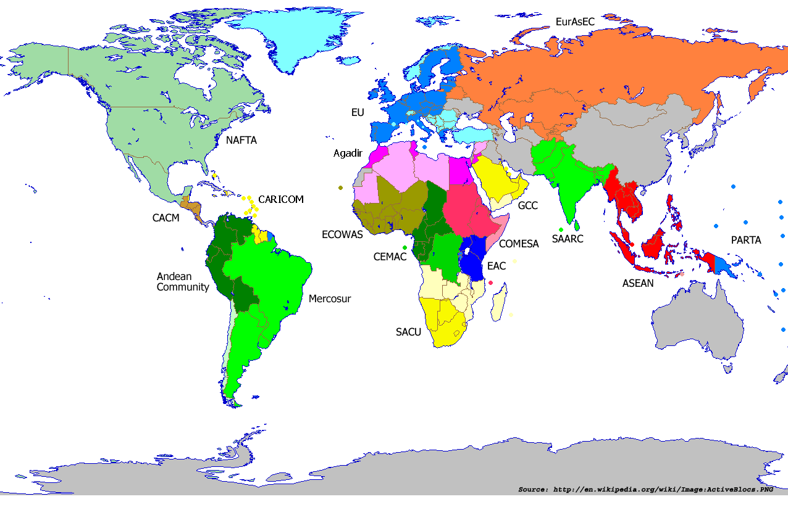
Free Trade
Removal of trade restrictions so that goods flow freely among countries

Slide 28
Interdependence
Condition that exists when countries rely on each other for ideas, goods, services, and markets

