Slide 1
Chapter 6 European Geography Vocabulary
Mr. Greaser

Slide 2
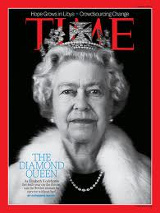
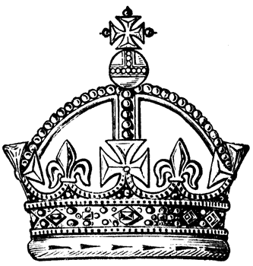
Constitutional Monarchy
Form of government in which a monarch is the head of state but elected officials run the government

Slide 3
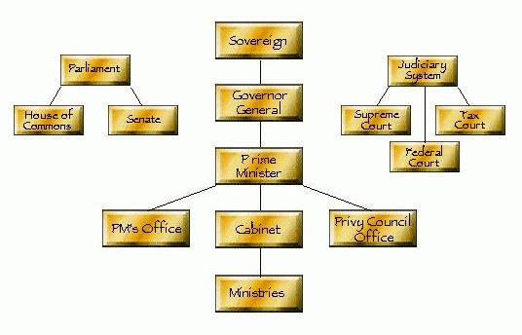
Parliamentary Democracy
Form of government in which voters elect representatives to a law-making body called Parliament, and members of Parliament vote for an official called the prime minister

Slide 4
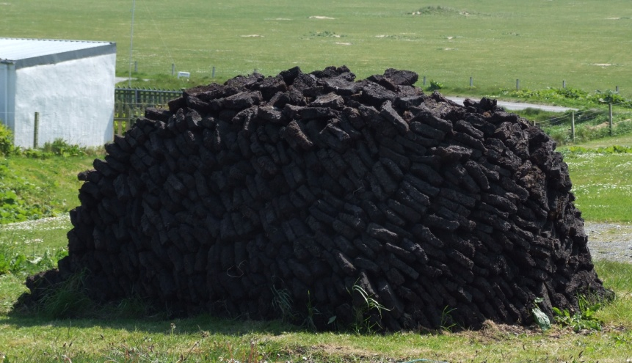
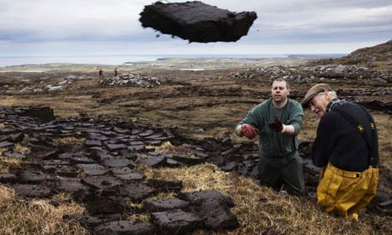
Peat
Plants partly decayed in water which can be dried and burned for fuel

Slide 5
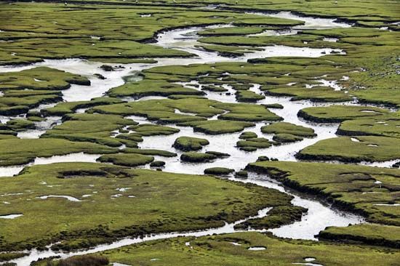
Bog
Low swampy area

Slide 6
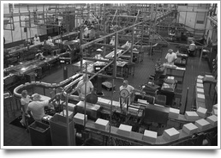
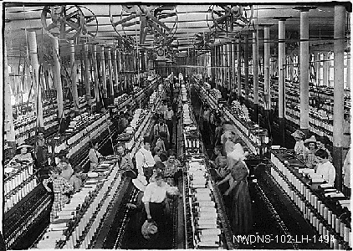
Productivity
Measurement of the amount of work accomplished in a given time

Slide 7
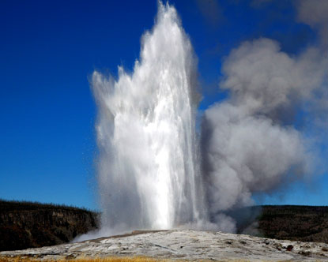
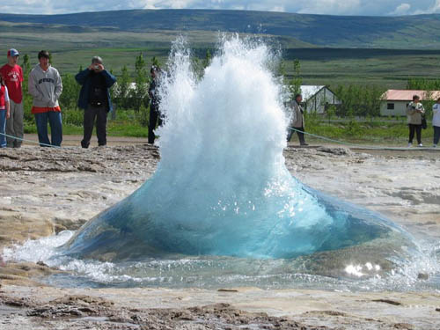
Geysers
Spring of water heated by molten rock inside the earth that, from time to time, shoots hot water into the air

Slide 8
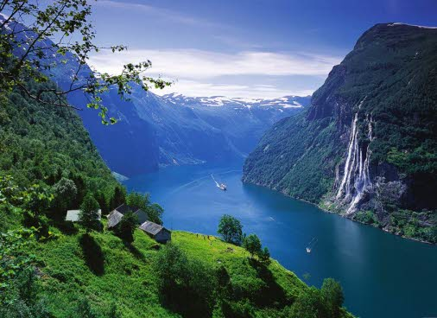
Fjord
Narrow, U-shaped coastal valley with steep sides formed by the action of glaciers

Slide 9
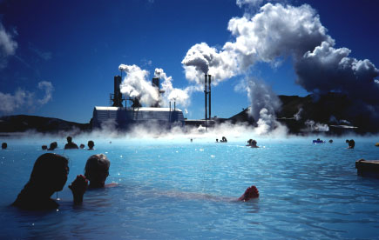
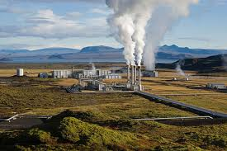
Geothermal Energy
Electricity produced by natural underground sources of steam

Slide 10
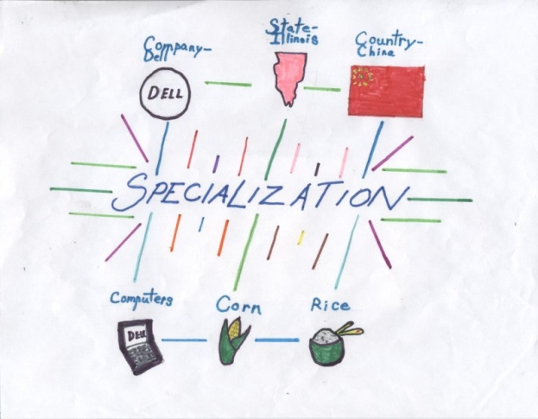
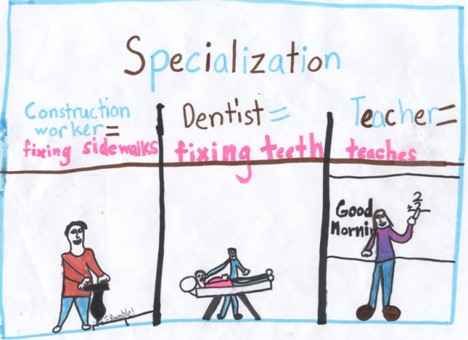
Specialization
Focusing on certain economic activities to make the best use of resources

Slide 11
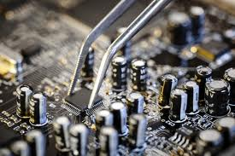
High-technology Industry
Areas of business that include making computers and other products with sophisticated engineering

Slide 12
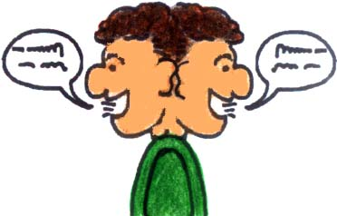
Bilingual
Accepting two official languages; able to speak two languages

Slide 13
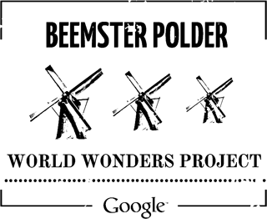
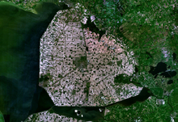
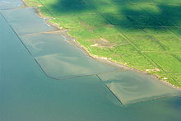
Polder
Reclaimed wetlands that use a system of dikes and pumps to keep out the sea’s water

Slide 14
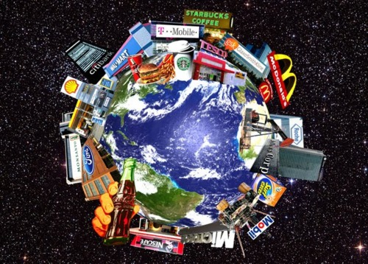
Multinational Company
Company that has locations in more than one country

Slide 15
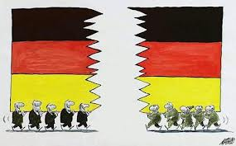
Reunification
The act of being brought back together

Slide 16
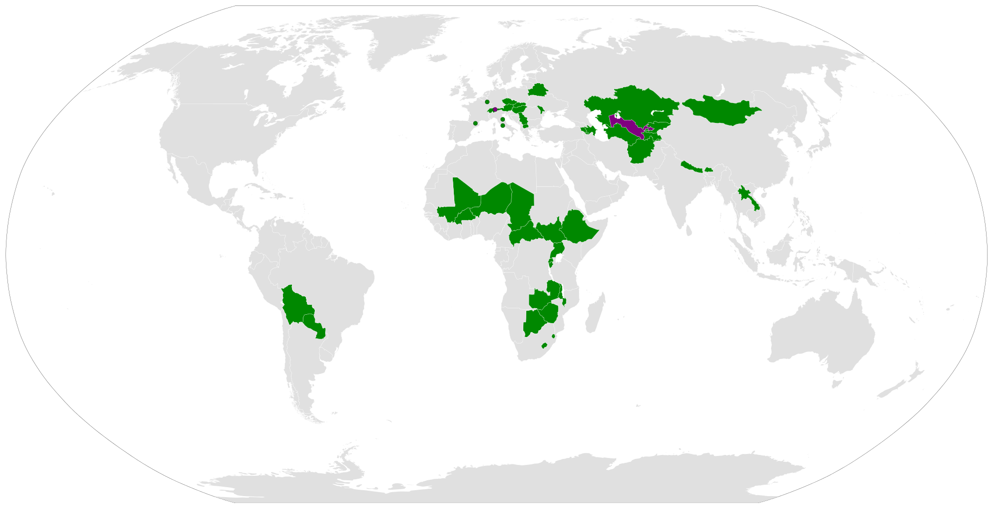
Landlocked
Having no border with ocean or sea

Slide 17
Neutrality
Refusal to take sides in a war between other countries

Slide 18
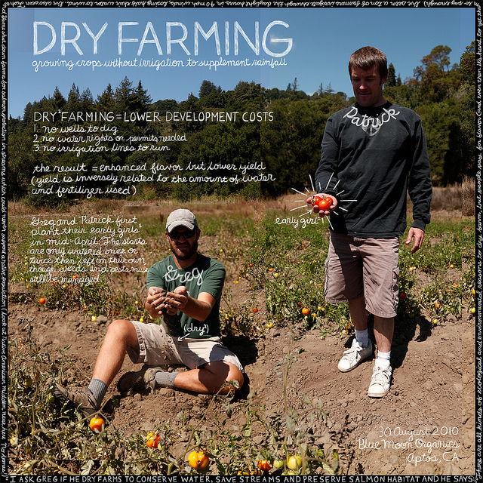
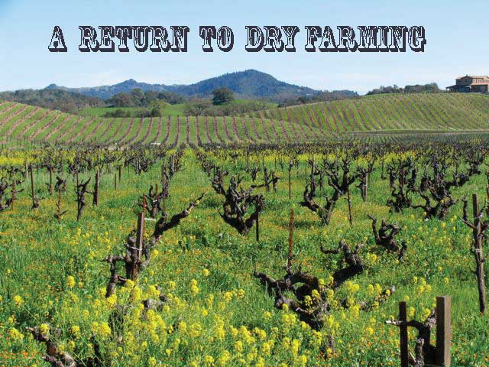
Dry Farming
Agriculture that conserves water and uses crops and growing methods suited to semiarid environments

Slide 19
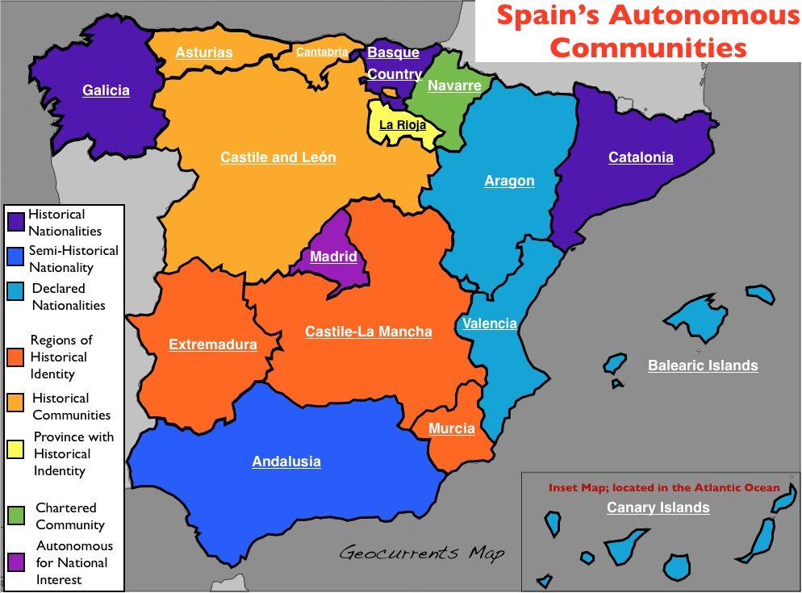
Autonomy
Having independence from another country

Slide 20
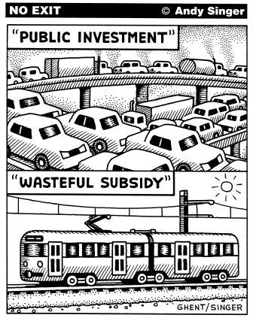
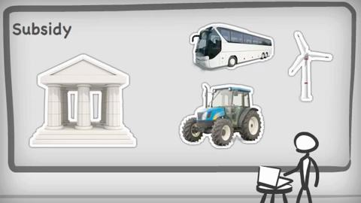
Subsidy
Special payment made by a government to support a particular group or industry

Slide 21
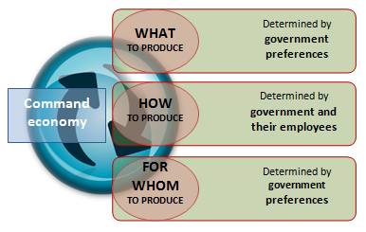
Command Economy
Economic system in which the government decides how resources are used and what goods and services are produced

Slide 22
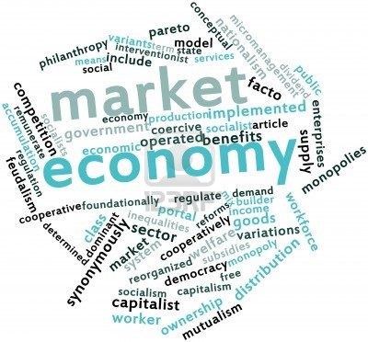
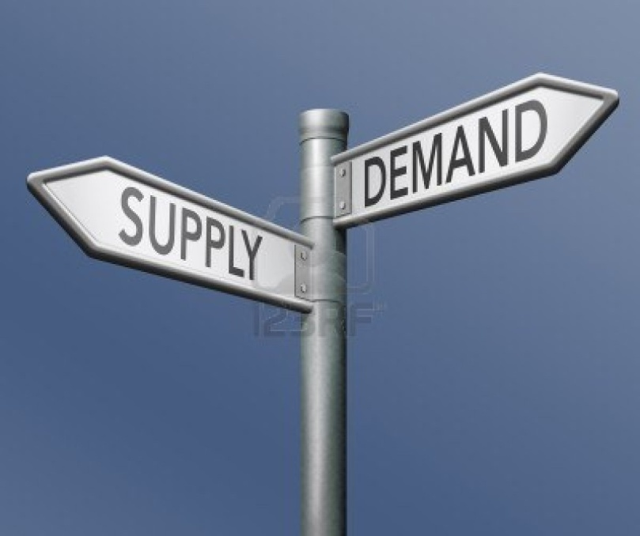
Market Economy
Economic system in which individuals make the decisions about how resources are used and what goods and services to provide

Slide 23
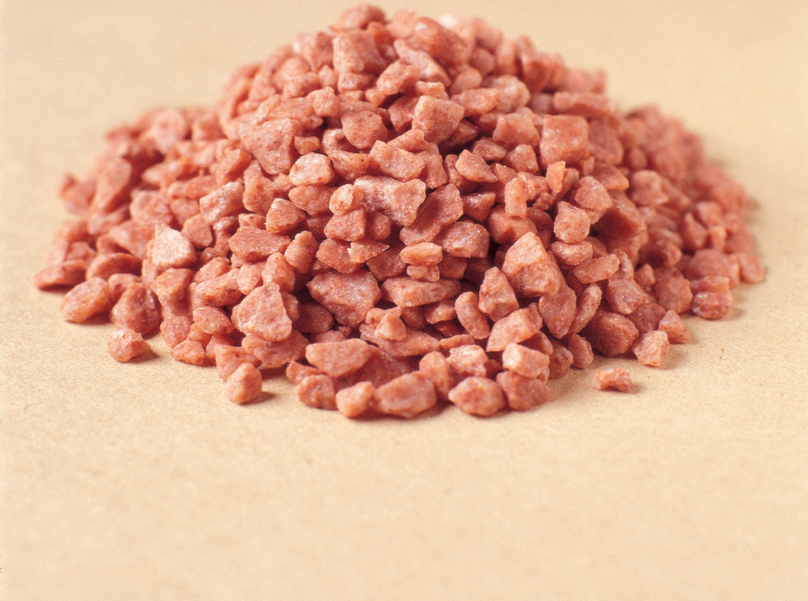
Potash
Mineral salt used in making fertilizer

Slide 24
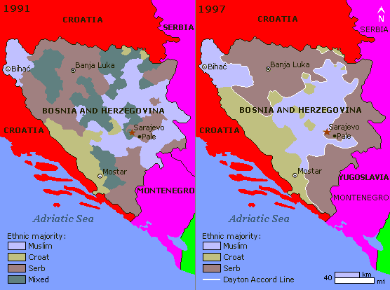
Ethnic Cleansing
Forcing people from one ethnic or religious group to leave an area so that it can be used by another group

